Slide 1
Multiprocessing using OpenMP

Slide 2
Introduction to OpenMP
Basic Components of OpenMP
OpenMP Parallel Regions
Controlling the Number of Threads
Parallelizing Loops with OpenMP
Loop-Carried Dependencies and Synchronization
How OpenMP Schedules for Loop Iterations

Slide 3
Introduction to OpenMP
What is OpenMP?
  A parallel programming model for shared-memory systems.
  Provides simple and flexible syntax for parallel programming.
  Uses compiler directives, runtime libraries, and environment variables to manage parallelism.
Why OpenMP?
  Easy to implement and efficient for parallelizing loops and tasks.
  Portable across platforms with minimal changes.

Slide 4
Basic Components of OpenMP
Compiler Directives: Instructions that tell the compiler how to parallelize the code.
#pragma is the key to OpenMP.
Runtime Functions: Used to control the behavior of parallel sections.
Example: omp_get_thread_num(), omp_set_num_threads().
Environment Variables: To control the number of threads, etc.
Example: OMP_NUM_THREADS sets the number of threads

Slide 5
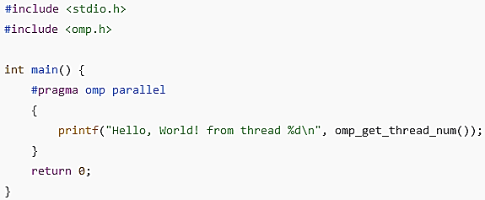
OpenMP Parallel Regions
Parallel Region: A block of code to be executed by multiple threads.
  #pragma omp parallel
  {
  // Code to be executed by each thread
  }

Slide 6
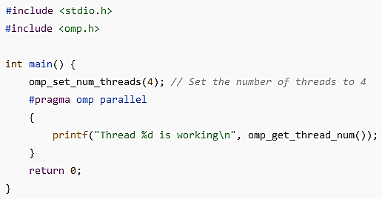
Controlling the Number of Threads
Through the OMP_NUM_THREADS environment variable or omp_set_num_threads()

Slide 7

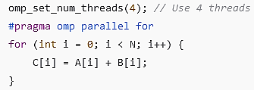
Parallelizing Loops with OpenMP
For Loop Parallelization:
  #pragma omp parallel for directive allows parallel execution of for loops

Slide 8
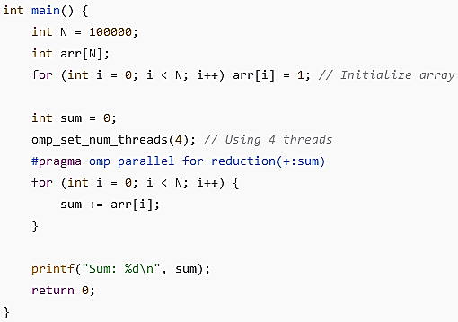
Parallelizing Loops with OpenMP
reduction(+:sum): A clause that ensures each thread maintains a private copy of the sum, and at the end, they are combined into the global sum.

Slide 9
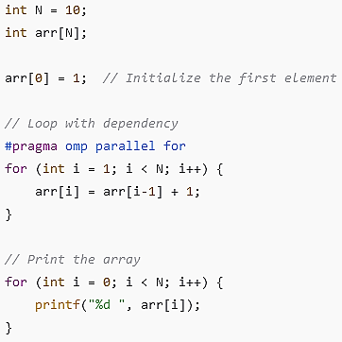
Loop-Carried Dependencies and Synchronization
When iterations of a loop are dependent on each other, meaning the result of one iteration affects the next.
Will it work?

Slide 10
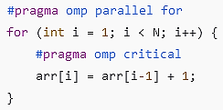
Loop-Carried Dependencies and Synchronization
This type of dependency cannot be easily parallelized using OpenMP without proper synchronization mechanisms, as threads may need to access data that is being modified by other threads.
Solution: Avoid parallelization in such cases, or use critical or atomic directives to ensure safe access to shared data.
The critical directive ensures that only one thread can execute the loop body at a time.

Slide 11
How OpenMP Schedules for Loop Iterations
OpenMP uses a static scheduling approach for distributing iterations of a loop across threads. However, OpenMP also provides options for dynamic scheduling, guided scheduling, and other strategies to control how iterations are assigned to threads.

Slide 12

How OpenMP Schedules for Loop Iterations
Static Scheduling (Default)
  How it works: OpenMP assigns a block of consecutive iterations to each thread before execution begins. This is the default scheduling type when no scheduling clause is specified.
For Threads = 4 , N = 12
  Thread 0 gets iterations 0-2.
  Thread 1 gets iterations 3-5.
  Thread 2 gets iterations 6-8.
  Thread 3 gets iterations 9-11.

Slide 13

How OpenMP Schedules for Loop Iterations
Dynamic Scheduling
How it works: OpenMP assigns a chunk of iterations to a thread, but threads request additional chunks as they finish processing. This is more flexible and adapts to uneven workloads.

Slide 14
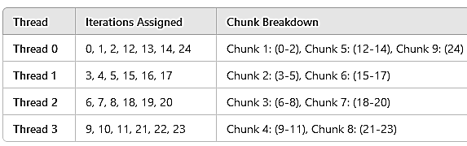
How OpenMP Schedules for Loop Iterations
How dynamic scheduling works in OpenMP for the sum of array elements example with 4 threads, N = 25, and a chunk size of 3

Slide 15
How OpenMP Schedules for Loop Iterations
Static versus Dynamic Scheduling

